Slide 1

Internet of Things - Introduction

Slide 2
Module Aims
The main aim of this module is to introduce the fundamental concepts of the Internet of Things and its applications and architecture models;
Introduction to the technologies and mechanisms for sensing, actuation, processing and cyber-physical data communication.
Discussing semantic technologies, service oriented solutions and networking technologies that enable the integration of Internet of Things data and services into the cyber world (i.e. the Internet and the Web).
To develop practical skills that can be transferred into a real-world environment.

Slide 3

IBM Mainframe 360, source Wikipedia

Slide 4
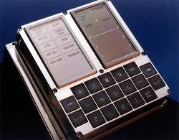
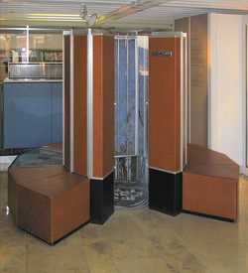
Apollo 11 Command Module (1965) had 64 kilobytes of memory
operated at 0.043MHz.
An iPhone 5s has a CPU running at speeds of up to 1.3GHz
and has 512MB to 1GB of memory
Cray-1 (1975) produced 80 million Floating point operations per second (FLOPS)
10 years later, Cray-2 produced 1.9G FLOPS
An iPhone 5s produces 76.8 GFLOPS – nearly a thousand times more
Cray-2 used 200-kilowatt power
Source: Nick T., PhoneArena.com, 2014

Slide 5
Computing Power
Smaller size
More Powerful
More memory and more storage
"Moore's law" over the history of computing, the number of transistors in a dense integrated circuit has doubled approximately every two years.

Slide 6
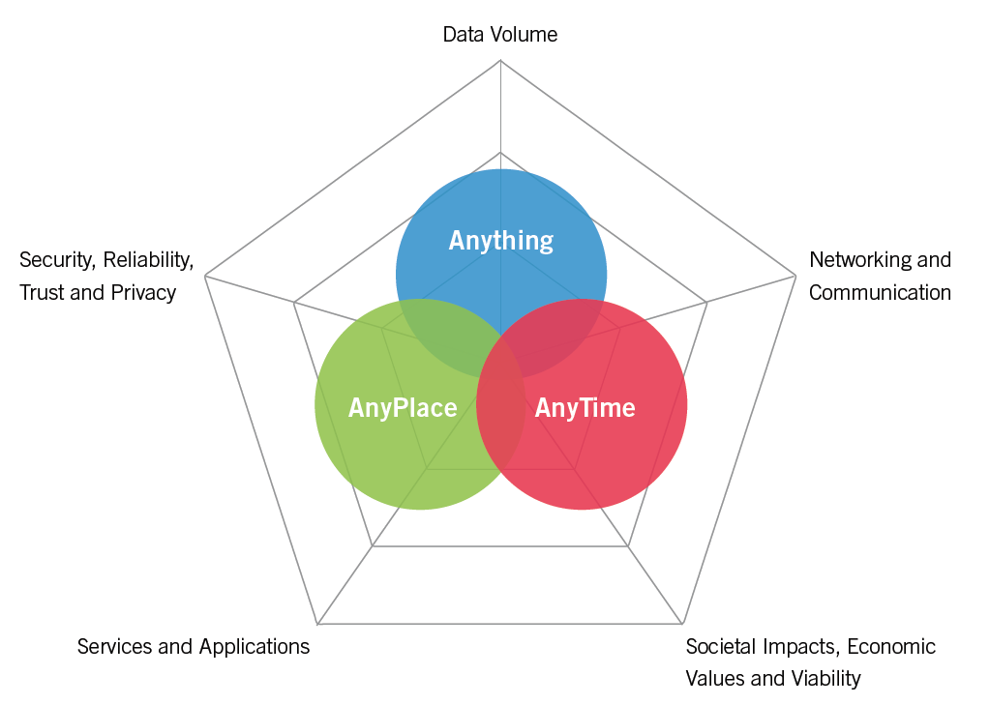
Cyber-Physical-Social Data
P. Barnaghi et al., "Digital Technology Adoption in the Smart Built Environment", IET Sector Technical Briefing, The Institution of Engineering and Technology (IET), I. Borthwick (editor), March 2015.

Slide 7
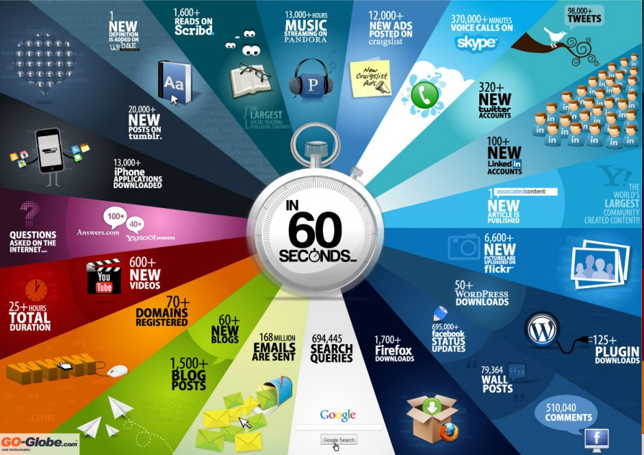

Slide 8
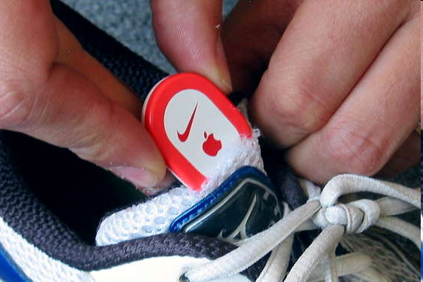
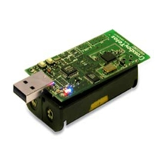
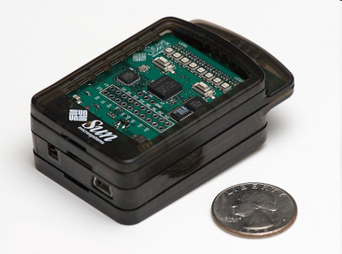
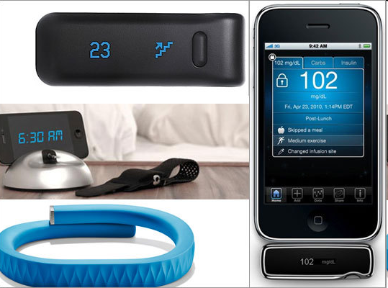
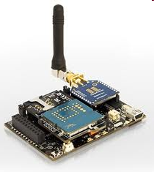
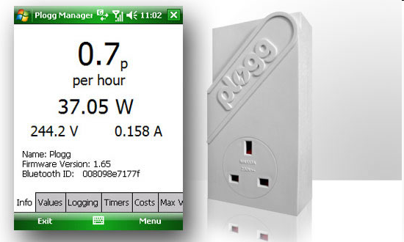
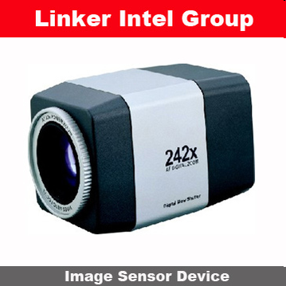
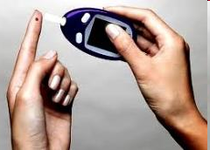
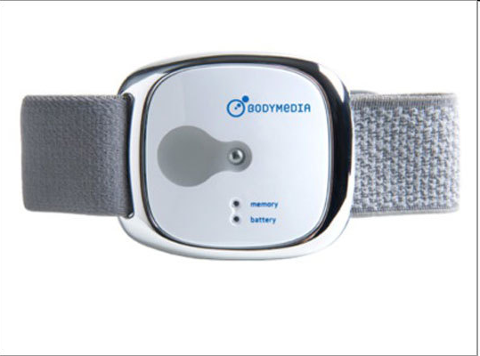
Sensor devices are becoming widely available
- Programmable devices
- Off-the-shelf gadgets/tools

Slide 9
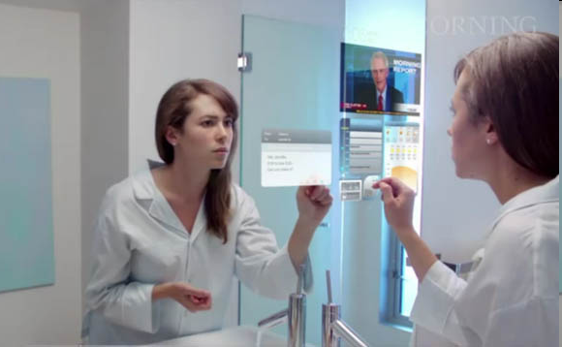
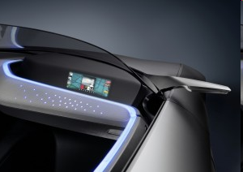
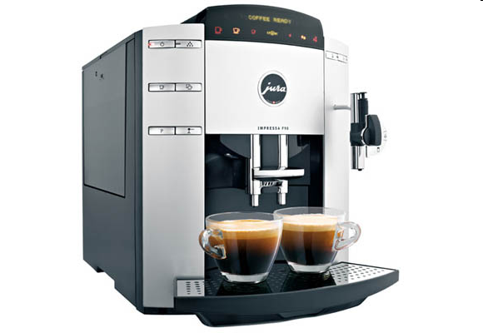
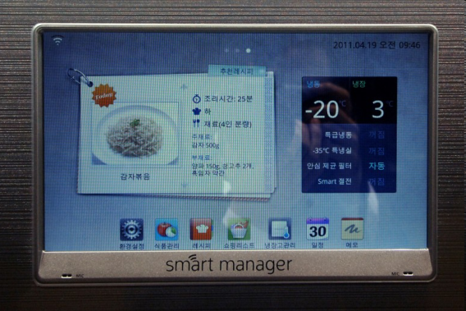
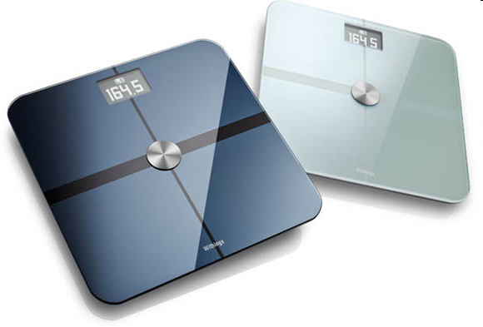
More “Things” are being connected
Home/daily-life devices
Business and
Public infrastructure
Health-care
…

Slide 10






People Connecting to Things
ECG sensor
Internet
Motion sensor
Motion sensor
Motion sensor

Slide 11
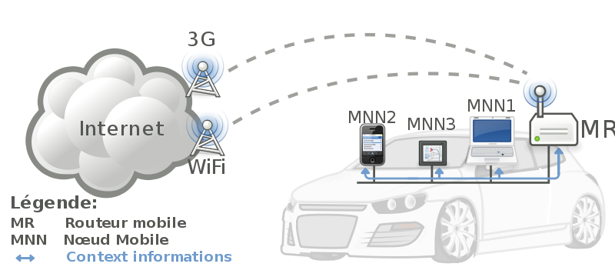


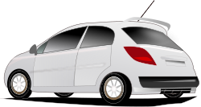
Things Connecting to Things
- Complex and heterogeneous
resources and networks

Slide 12






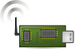
Wireless Sensor Networks (WSN)
End-user
Core network
e.g. Internet
Gateway
Sink
node
Gateway
Computer services
The networks typically run Low Power Devices
Consist of one or more sensors, could be different type of sensors (or actuators)

Slide 13
How are the networks changing?
Extensions
More nodes, more connections
Any TIME, Any PLACE + Any THING
M2M, IoT
Billions of interconnected devices,
Everybody is connected.
Expansions
Broadband
LTE, 5G
Enhancements
Smart networks
Data-centric and content-oriented networking
Context-aware (autonomous) systems

Slide 14
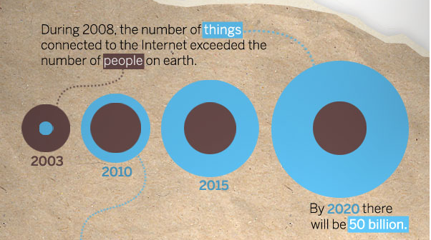
“Thing” connected to the internet
Source: CISCO

Slide 15
Internet of Things (IoT)
Extending the current Internet and providing connection, communication, and inter-networking between devices and physical objects, or "Things," is a growing trend that is often referred to as the Internet of Things.
“The technologies and solutions that enable integration of real world data and services into the current information networking technologies are often described under the umbrella term of the Internet of Things (IoT)”

Slide 16
From any time ,any place connectivity for anyone, we will now
have connectivity for anything!

Slide 17
Why should I learn about IoT?
Emerging technologies
Growing IoT Services and Applications in various areas including smart cities, healthcare, transport, logistics, retail, safety and security, etc.
Business trends and new opportunities

Slide 18
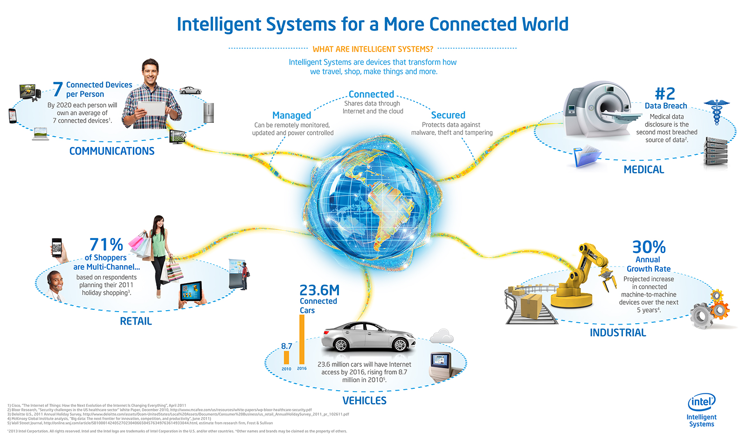
Opportunities
Source: http://blog.trentonsystems.com/internet-of-things-crosses-business-personal-boundaries/

Slide 19
History of IoT
1997, “The Internet of Things” is the seventh in the series of ITU Internet
Reports originally launched in 1997 under the title “Challenges to the Network”
1999, Auto-ID Center founded in MIT
2003, EPC Global founded in MIT
2005, Four important technologies of the internet of things was
proposed in WSIS conference, nano tech, wireless sensor, RFID and smart tech
2008, First international conference of internet of things: The IOT 2008 was held at Zurich

Slide 20
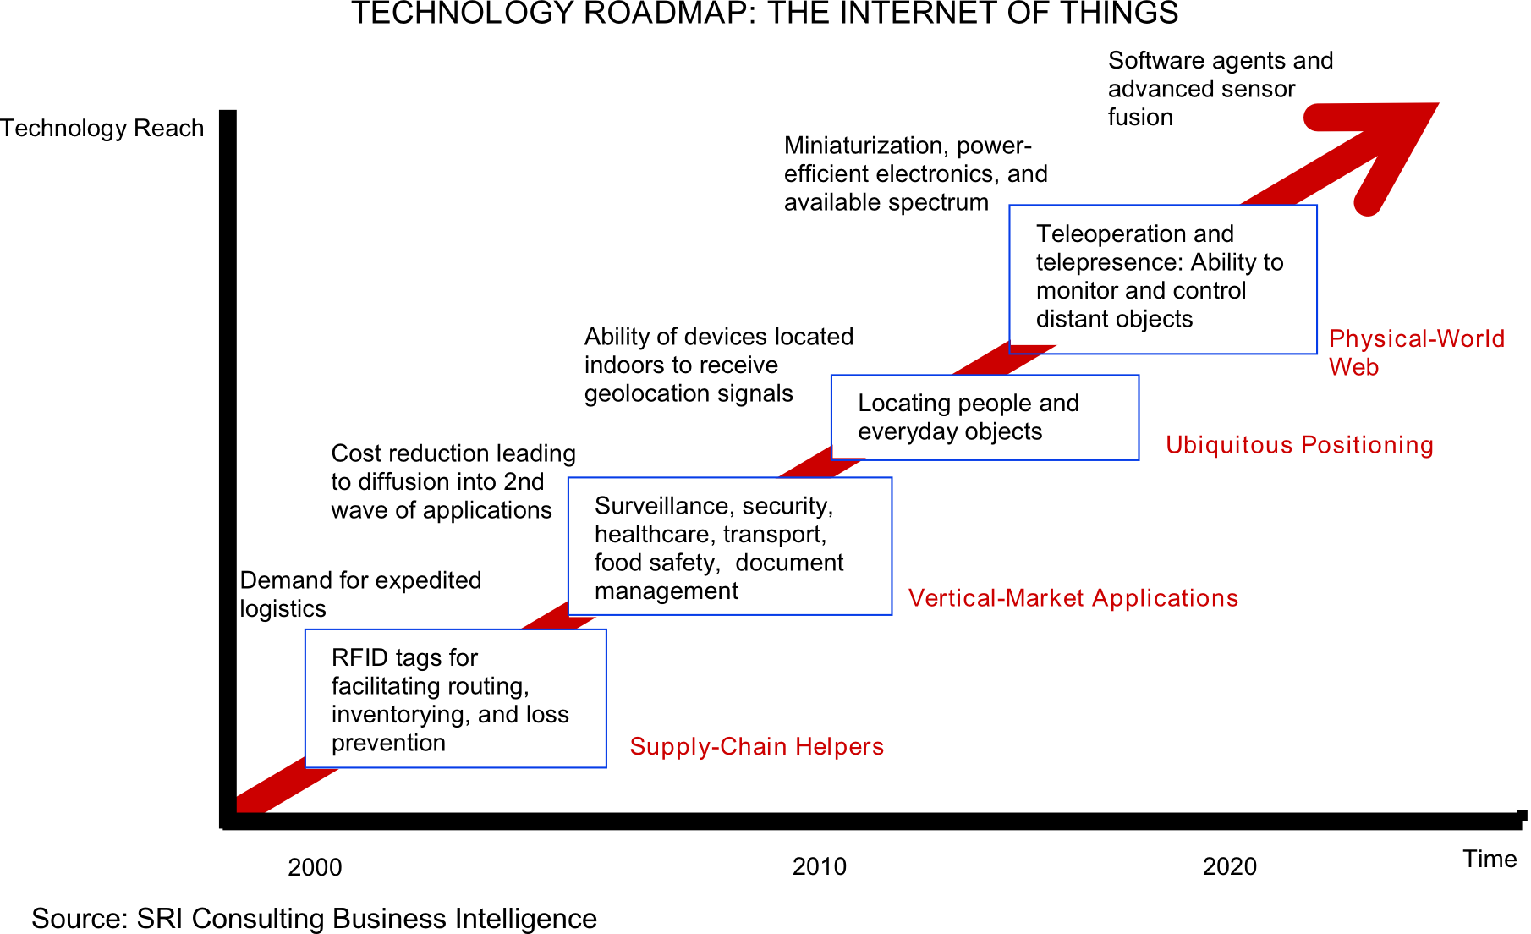
Technology trend

Slide 21
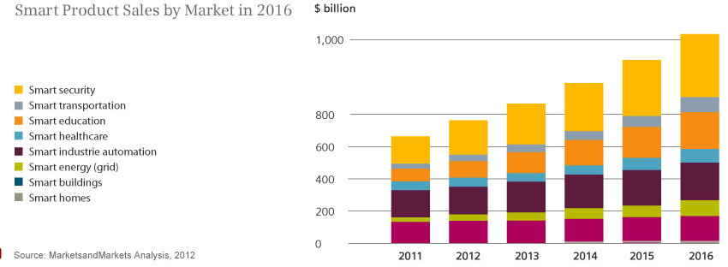
Smart product sales
Source: Siemens, http://www.siemens.com/innovation/apps/pof_microsite/_pof-fall-2012/_html_en/facts-and-forecasts-growth-market-of-the-future.html

Slide 22
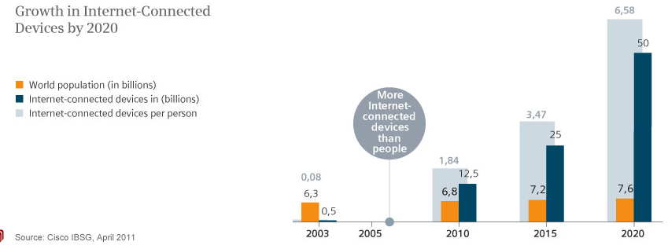
Internet Connected devices
Source: Siemens, http://www.siemens.com/innovation/apps/pof_microsite/_pof-fall-2012/_html_en/facts-and-forecasts-growth-market-of-the-future.html

Slide 23
Global Data Generation
Everyday around 20 quintillion (10^18) bytes of data are produced (Source: http://www-01.ibm.com/software/data/bigdata/).
- This data includes textual content (unstructured, semi-structured, structured) to multimedia content (images, video and audio), on a variety of platforms (enterprise, social media, and sensors).

Slide 24
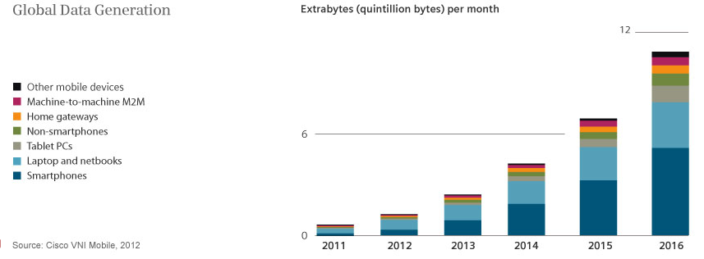
Data Generation

Slide 25
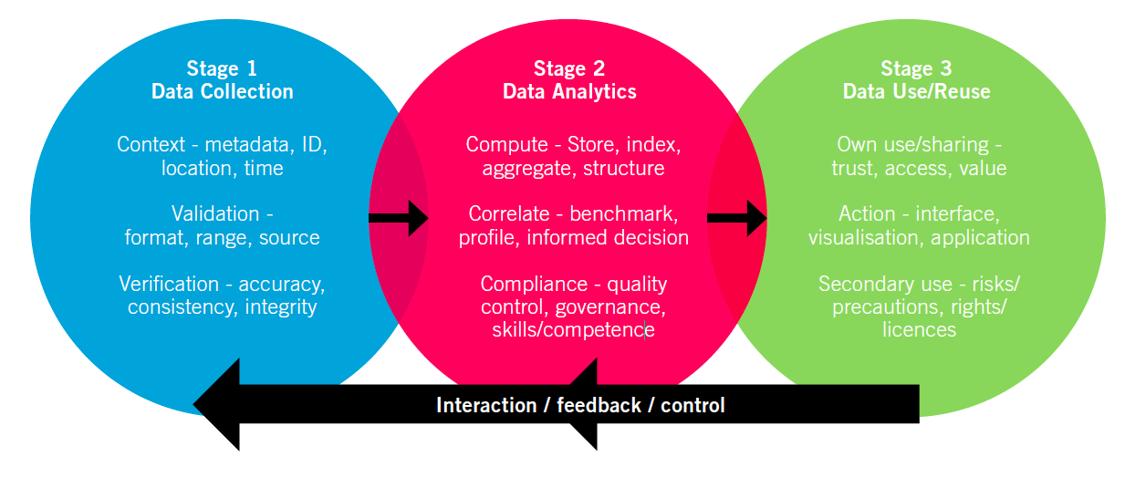
Data Lifecycle
Source: The IET Technical Report, Digital Technology Adoption in the Smart Built Environment: Challenges and opportunities of data driven systems for building, community and city-scale applications, http://www.theiet.org/sectors/built-environment/resources/digital-technology.cfm

Slide 26
“The ultimate goal is transforming the raw data to insights and actionable knowledge and/or creating effective representation forms for machines and also human users and creating automation.”
This usually requires data from multiple sources, (near-) real time analytics and visualisation and/or semantic representations.

Slide 27
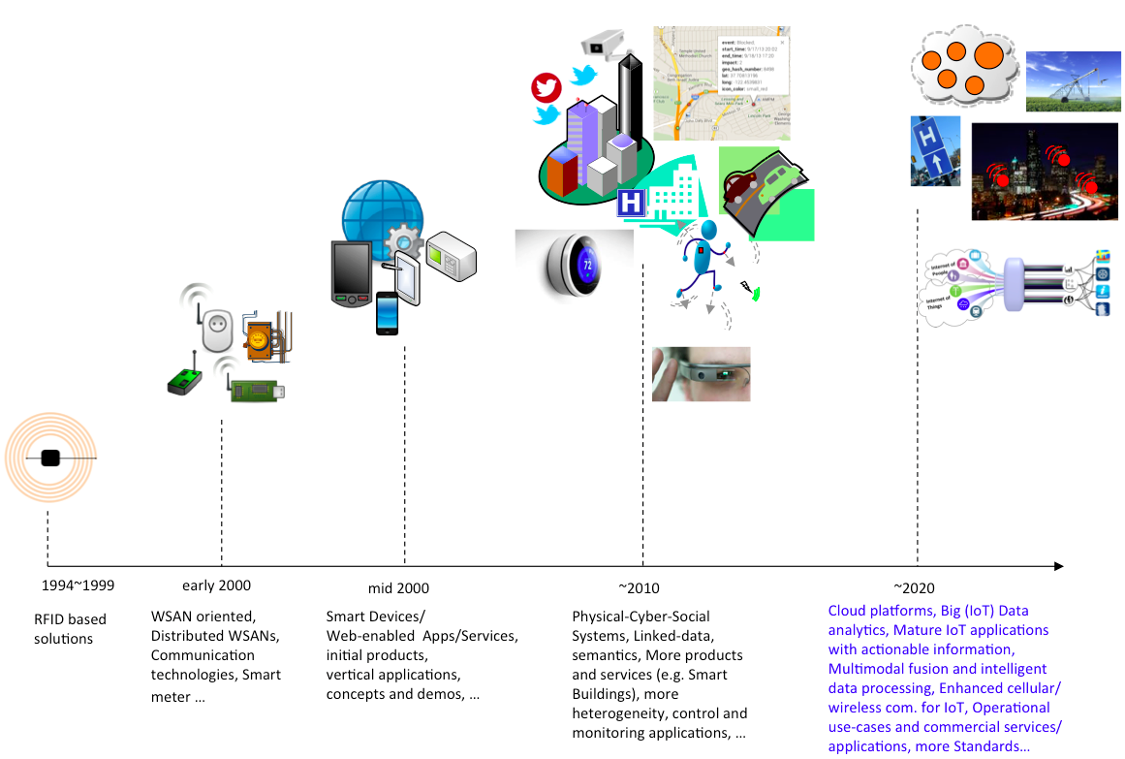
Internet of Things
P. Barnaghi, A. Sheth, “Internet of Things, The story so far”, IEEE IoT Newsletter, September 2014.

Slide 28
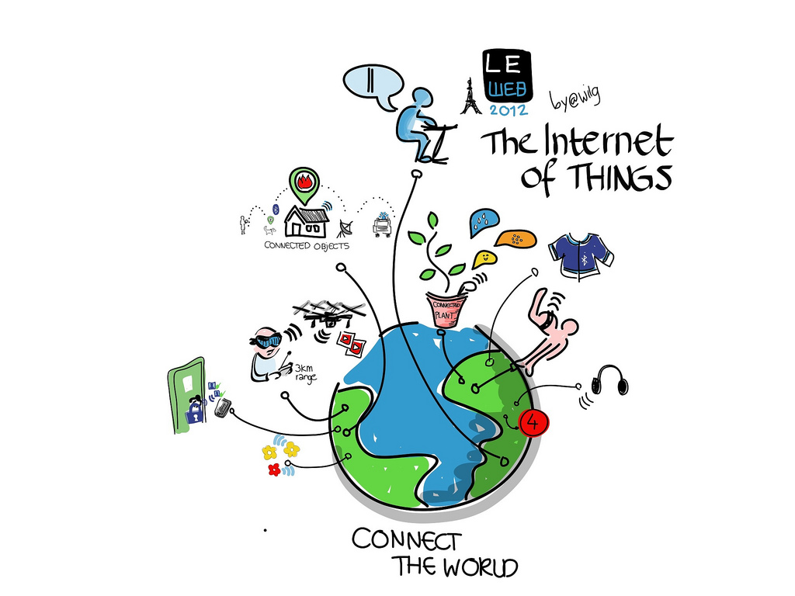
Internet of Things Module
Image courtesy: Wilgengebroed

Slide 29
Topics
Cyber-Physical systems, smart devices, sensors and actuators
Key applications, protocols and architectures
Networks and Communications (Wireless Multi-hop Networks (WMN), Mobile Ad-hoc Networks (MANET), Wireless Sensor Networks (WSN))
Reliability, Security, Privacy and Trust issues and solutions
Software platforms and services
Intelligent Data Processing and Semantic technologies
Connecting Things to the Web (Web of Things)
Applications, system models, Standards, and Physical-Cyber-Social systems (invited industry speaker?)

Slide 30
Module Web Link
All the slides and additional material will be uploaded to SurreyLearn
http://surrylearn.surrey.ac.uk

Slide 31
Some of the related material
Reading List:
http://aspire.surrey.ac.uk/lists/35640FC8-892D-E309-E66C-F07C3D9BCB28.html

Slide 32
IoT Architecture
Three major components for designing any IoT system
Application devices: Hardware architecture, smart sensors, cloud computing, energy efficient devices
Networks: Communication technology, advanced internet protocol, wireless technology, RFID technology
Security and privacy: Authentication procedure, secure device discovery, secure inter-device communication

Slide 33
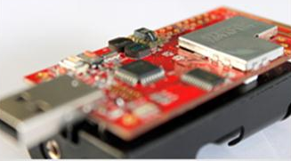
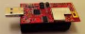
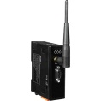

Overview: Hardware Platform
IEEE 802.15.4 2.4GHz RF System
User/Environment
2 sensors
“Thing”
Sensors & Actuators
XM1000
Device level
Communications
Network
Gateway
The Internet
Network level
The Internet
Servers

Slide 34
Sensors & Actuators
Sensors:
They are mainly input components
They sense and collect surrounding information
Basically three types:
Passive, omnidirectional (e.g. mic)
Passive, narrow-beam sensor (e.g. PIR)
Active sensors (e.g. sonar, radar, etc.)
Actuators:
They are mainly output components
They alter the surrounding. Some examples:
Adding lighting, heat, sound, etc.
Controlling motors to move objects
Displaying messages
and others…

Slide 35
Things
We can turn almost every object into a “thing”.
A “thing” still looks much like an embedded system currently.
A “thing” generally consists of four main parts:
Sensors & actuators
Microcontroller
Communication unit
Power supply
A “thing” has the following properties:
It’s usually powered by battery. This implies limited source of energy.
It’s generally small in size and low in cost. This limits their computing capability.
It doesn’t usually perform complicated tasks.
Power consumption is the main design issue.

Slide 36
Communications
A “thing” always feature communications for “team working”
The Role of Communications
Providing a data link between two nodes
Communication type:
Wireline (e.g. copper wires, optical fibers)
Wireless (e.g. RF, IR). RF-based communication is the most popular choice (and also our focus)
Popular RF-based communication solutions:
IEEE 802.15.4 ← used in XM1000
IEEE 802.11 (or Wifi)
Bluetooth
Near Field Communication (NFC), e.g. RFID

Slide 37
Networks
The Roles of Networks
Managing nodes (discovery, join, leave, etc).
Relaying data packets from the source to the destination node in the network.
Networks are a distributed system. All nodes need to perform networking related tasks.
RF-based Network in IoT is usually a Wireless Multi-hop Network. Some examples:
Wireless Sensor Networks (WSNs)
Mobile Wireless Ad hoc Networks (MANETs)
Wireless Mesh Networks (WMNs)
Vehicular Ad Hoc Networks (VANETs)
and others...
Main concern: Reliability & Performance

Slide 38

The Internet
The Internet serves as a wide area networking for a local network.
The Internet uses TCP/IP. This implies that things must also support TCP/IP.
Gateway (or sink)
For a practical deployment, a gateway is often needed in a network.
It offers relaying packets between the network and the Internet.
The Internet
Data link
Gateway
Network

Slide 39

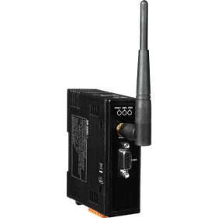
Protocol Stack
Thing
Thing
Application
Application
TCP/UDP
TCP/UDP
Network (IP)
Network (IP)
IEEE 802.15.4 PHY/MAC
IEEE 802.15.4 PHY/MAC
Wireless Medium
Server
Application
Gateway
TCP/UDP
Network (IP)
Network (IP)
The Internet
IEEE 802.3 (Ethernet)
IEEE 802.3 (Ethernet)
IEEE 802.15.4 PHY/MAC

Slide 40
Security & Privacy
Are they important?
What is the risk?
What are the challenges?
Device level
Network level
System level
User level
Solutions?

Slide 41
Software Platforms and Services
Operating Systems and execution environments
Contiki, TinyOS
Relevant protocols and standards
6LoWPan, CoAP
Architecture reference models
ETSI M2M architecture and components
Gateway/middleware
Types of services
In conventional communication networks the target is moving bits from one place to another
In the IoT moving the data is not the actual goal.
The IoT is expected to facilitate providing meaningful information/actions.

Slide 42
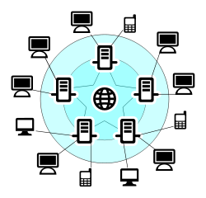



Example: Type of Services in IoT
Data
Data
Sender
Receiver
A sample data communication in conventional networks
Fire!
Some bits
01100011100
Core network
e.g. Internet
End-user
Sink
node
Gateway
A sample data communication in WSN

Slide 43
Intelligent Data Processing
Sensing and data collection, sensor data and data-centric networks
Access, subscription and integration
Data processing and stream data analysis
Query and discovery
Data classification and clustering

Slide 44

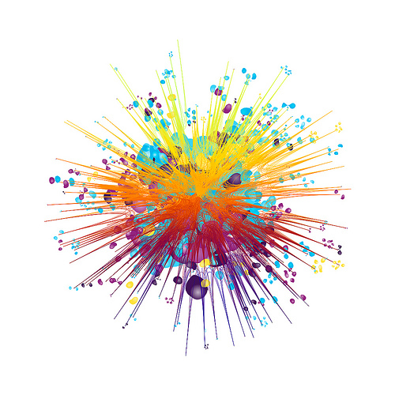

Things, Data, and lots of it
image courtesy: Smarter Data - I.03_C by Gwen Vanhee

Slide 45
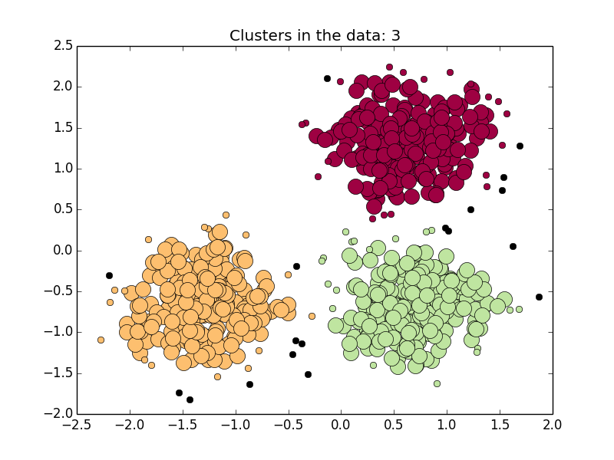
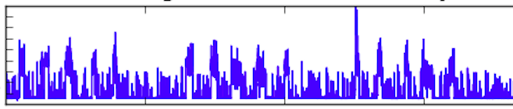
“Each single data item is important.”
“Relying merely on data from sources that are unevenly distributed, without considering background information or social context, can lead to imbalanced interpretations and decisions.”
?

Slide 46
IoT Data- Challenges
Multi-modal and heterogeneous
Noisy and incomplete
Time and location dependent
Dynamic and varies in quality
Crowed sourced data can be unreliable
Requires (near-) real-time analysis
Privacy and security are important issues
Data can be biased- we need to know our data!

Slide 47








“People want answers, not numbers” (Steven Glaser, UC Berkley)
Freezing!
What is the temperature at home?
Core network
e.g. Internet
Sink
node
Gateway

Slide 48
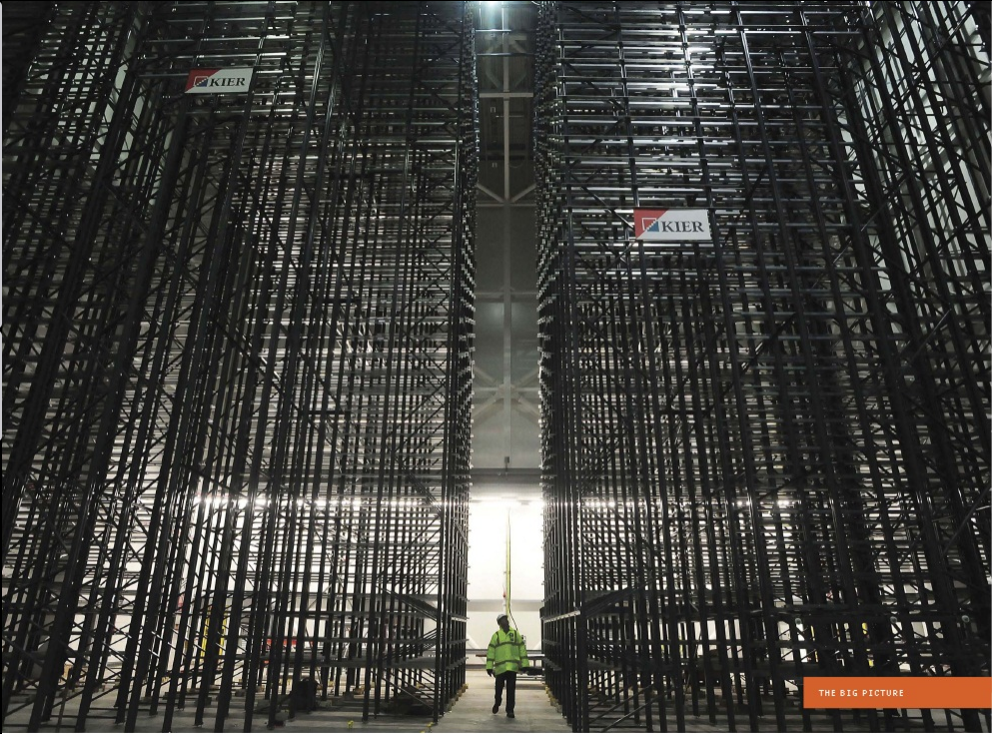
Storing, Handling and Processing the Data
Image courtesy: IEEE Spectrum

Slide 49
Semantic technologies and connecting Things to the Web
Meta-data models and schemas
Linked data and Linked IoT data concepts
Semantic technologies and semantic sensor networks
Interoperability issues
Web of Things

Slide 50
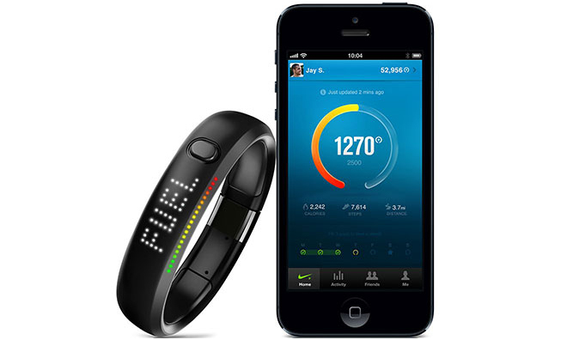
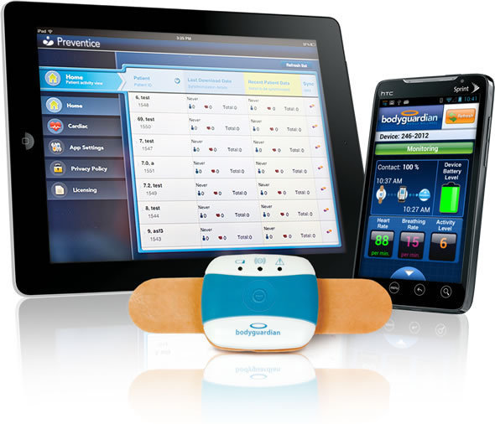
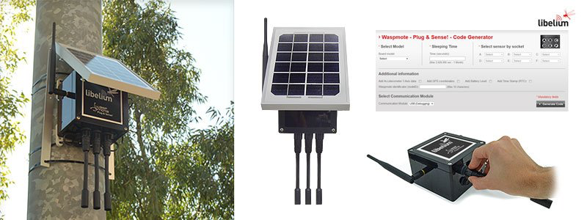
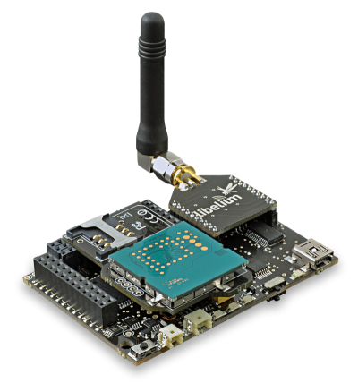
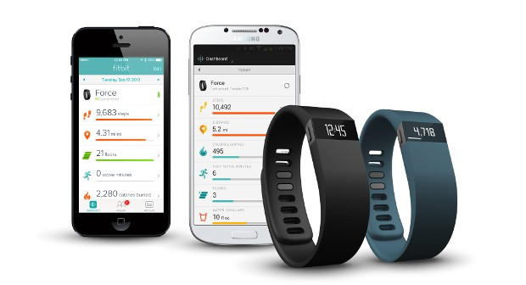
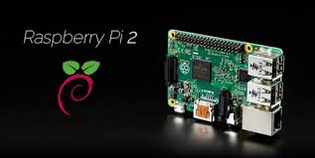
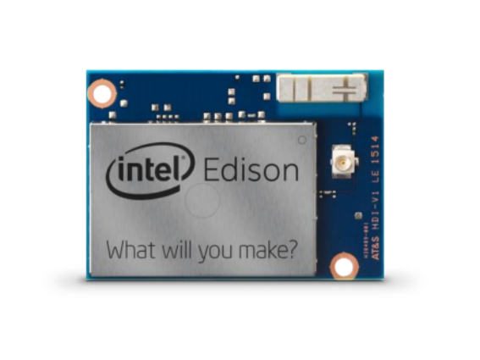
Device/Data interoperability
The slide adapted from the IoT talk given by Jan Holler of Ericsson at IoT Week 2015 in Lisbon.

Slide 51
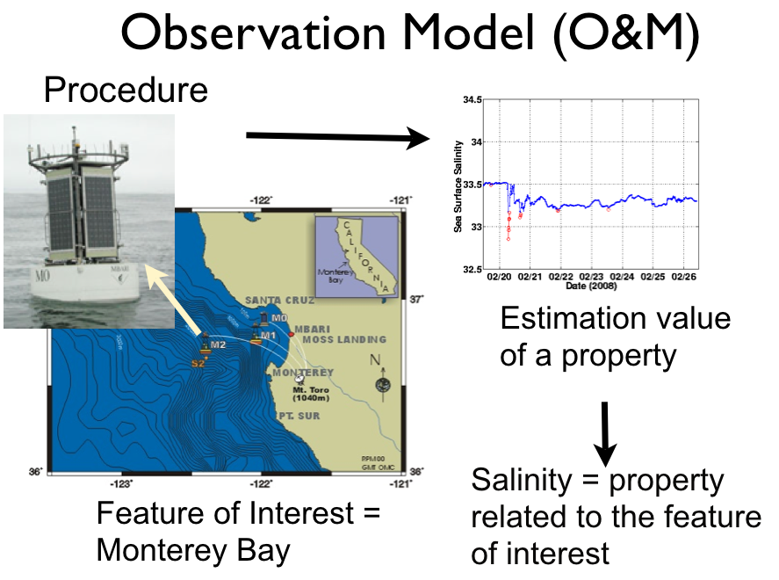
Observation and measurement data
Source: W3C Semantic Sensor Networks, SSN Ontology presentation, Laurent Lefort et al.

Slide 52
System models, Applications and Standards
Applications: Smart City, Smart Homes, Healthcare, Smart Grid,
Physical-Cyber-Social Systems
Machine-to-machine communications
System models and Standards

Slide 54

Questions?

